Slide 1
Developing daily gap-filled chlorophyll-a datasets using deep neural networks with co-located environmental variables
Shridhar Sinha (1), Yifei Hang (2), Elizabeth Eli Holmes (3)
University of Washington, Paul G. Allen School of Computer Science & Engineering, ssinha19@uw.edu
University of Washington, Applied & Computational Mathematical Sciences, yhang2@uw.edu
NOAA Fisheries, Northwest Fisheries Science Center, eli.holmes@noaa.gov
August 8, 2024
Notes:
Eli –
Varanasi Internship at the Univ of WA
Shridhar - as it sounds - rising senior
Hong - rising senior

Slide 2
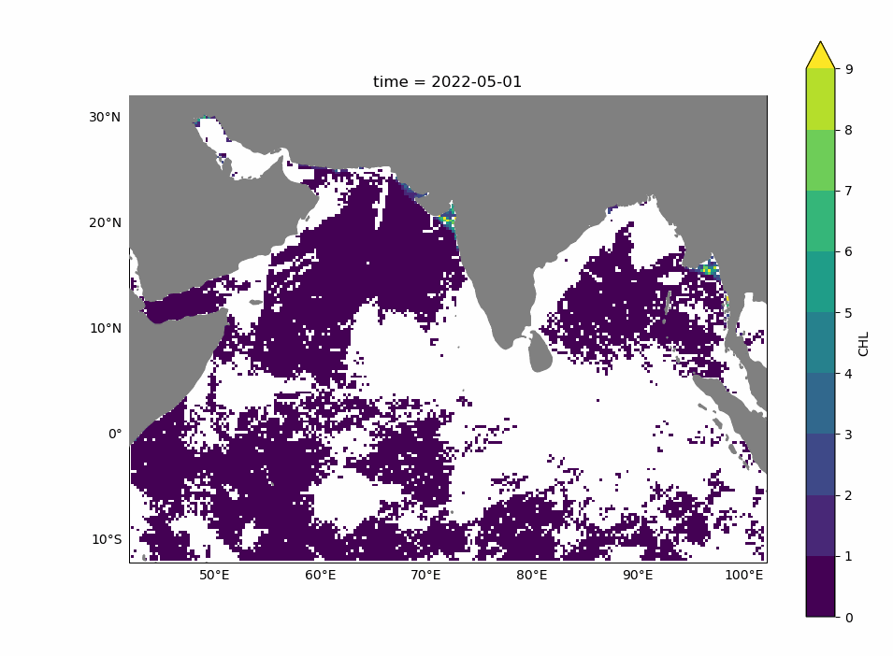
The Problem: Missing Chlorophyll Data
The Arabian Sea and Bay of Bengal exemplify the problem: white are clouds (NAs)
Somalia
India
Notes:
Shridhar
Key indicator for ocean productivity, crucial for understanding marine ecosystems and managing fisheries.
Limited by the inability to penetrate cloud cover, leading to missing Chl-a data.
High fraction of missing data complicates monitoring efforts, especially in regions with frequent cloud cover.

Slide 3
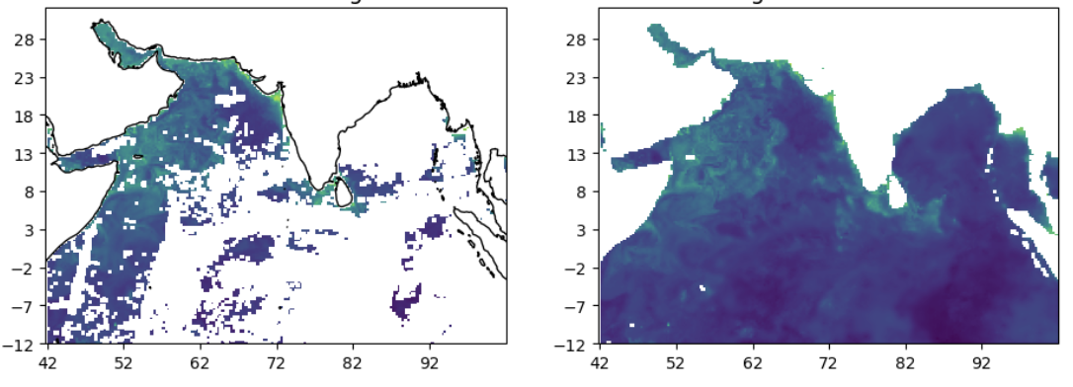
Solution: Gap-filling algorithms
Notes:
Shridhar
The most commonly available Chl-A data for such is regions is due to gap-filling computer algorithms

Slide 4
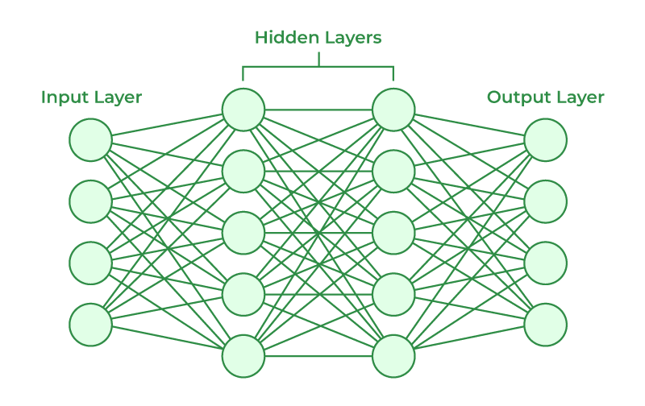
Our work: comparing two different deep neural nets for gap-filling
Observed Chl-a &
Environmental variables on a grid
gap-filled Chl-a on a grid
Notes:
Shridar
You’ll be hearing about U-Net models from Yifei and I’ll talk about physics informed neural nets

Slide 5
Why use neural nets?
1. Universal Function Approximation Theorem
Any non-linear relationship can be arbitrarily approximated by a suitable neural network of ONLY one hidden layer.
2. Advantages of Deep Networks
By extending past one hidden layer, we can learn hierarchical features automatically, and scalably.
3. Convolutional Neural Networks (CNNs) for Images
Learn local patterns and features in the image. Better fit for image data compared to standard algorithms that are used in traditional regression techniques.
Notes:
Shridar

Slide 6
Adding Environmental Variables to neural networks
This is a new area of research for neural networks with earth sensing data.
1. Environmental variables affect Chlorophyll-a concentrations
2. Neural networks: able to learn non-linear and spatial relationships
3. Maximize the use of all information for better predictions
4. May provide a new approach for making Chl-a predictions when there is no Chl-a observations (pre-1997)
Notes:
Shridar
Chlorophyll levels are influenced by multiple interrelated environmental factors
Altho Some relationships between env data & chl concentration are more complex, nn will be able to learn most of the relationships.

Slide 7
What variables to use?
Random Forest and Gradient-Boosted Trees were used to explore the important variables:
SST: Sea Surface Temperature
N-S Wind (uwind): North-South Wind (Eastward Wind)
E-W Wind (vwind): East-West Wind (Northward Wind)
adt: Absolute Dynamic Topography (sea surface height)
air_temp: Air Temperature
curr_dir: Current Direction
curr_speed: Current Speed
mlotst: Mixed Layer Depth
sla: Sea Level Anomaly
so: Salinity
From a combination of sources. Link to Indian Ocean dataset documentation
Notes:
Shridar
Random Forest and Gradient-Boosted Trees learn and reveal non-linear dependencies

Slide 8
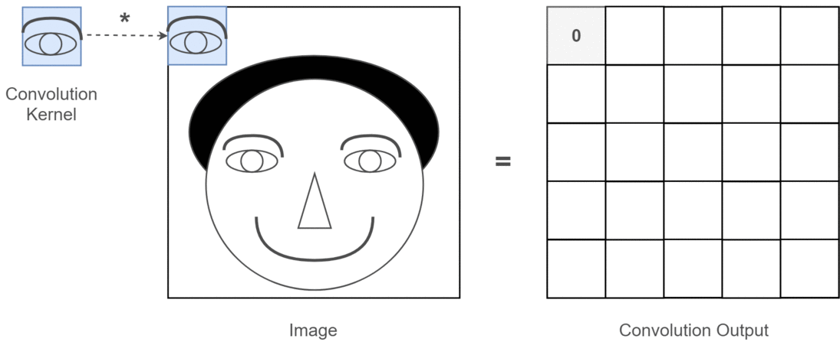
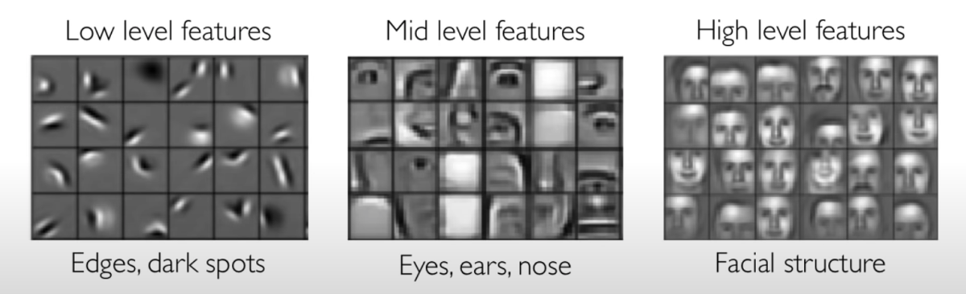
CNN models: a type of neural network
Unfortunately The Section Header is Manual
Local Feature Detection
Features are LEARNED
Hierarchical Learning
Notes:
Yifei
Cnn: for image, video, or other high dimensional data
Due to its ability of Local feature detection and Hierarchical learning
Simple words: model
LEARN filters that transform the input data to find various patterns (features of the input)
A typical model is
Consisted of several convolutional layers. -> learn increasingly complex features through these multiple layers
Filters are orders of magnitude smaller than the input dimensions, so…
Say we are identifying faces for a set of images.
Earlier filters: simpler and more geometric, detecting edges, corners, simple shapes and patterns
Later layers: more complex filters that detect shapes, objects, and other structures
——————SKIP——————
Gif: mid level
Have a kernel/filter of an eye, go through the whole image to detect where the eyes lie
Conv output: highly abstract image representing location of the eyes
Use other filters that detector nose, mouth, etc., have different conv outputs
These outputs will be inputs of the high level layers, and the high level filters will be able to detect facial structures.
1. Local Feature Detection
Convolutional Layers: Automatically extract local patterns and features, such as edges and textures.
3. Hierarchical Learning
Layered Structure: Learns increasingly complex features through multiple layers, improving image representation and classification.
2. Parameter Efficiency
Weight Sharing: Reduces the number of parameters and computational complexity by applying filters across the entire image.

Slide 9
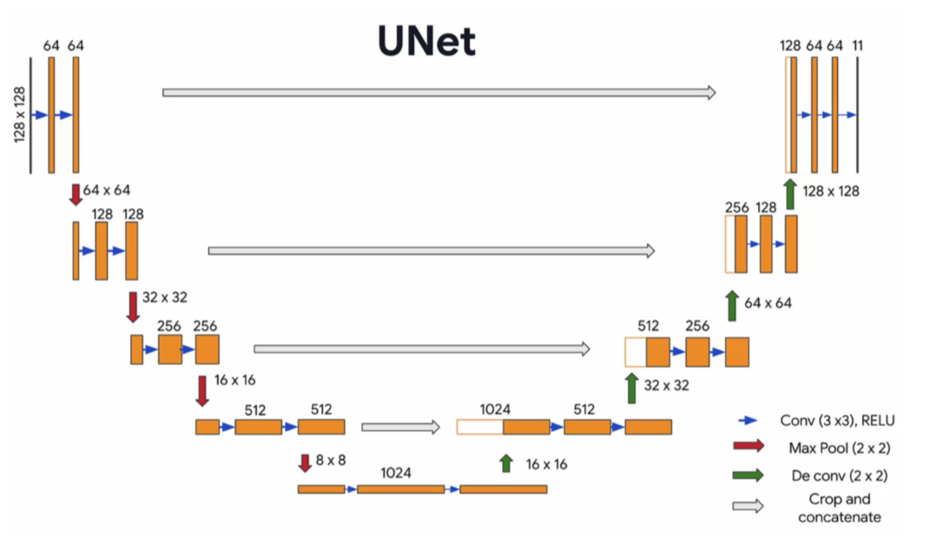
U-Net architecture: a type of CNN model
Unfortunately The Section Header is Manual
Decoder
Encoder
Notes:
Yifei
UNet: a particular arch of the cnn
Follows an encoder-decoder structure
Encoder half: feature extraction (as described in the cnn slide)
Decoder half: generate the prediction using features learned from the encoder half
Start from the higher-level features to build the overall pattern
Then use the lower-level features to fill in the details

Slide 10
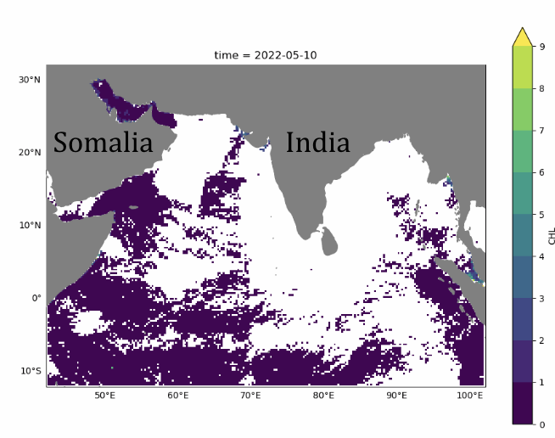
Training and testing the predictive model
Train (parameters)
Validate (tune model structure)
Test (compare predictions to held out data)
Data: Global Ocean Colour (Copernicus-GlobColour) level 3 with gaps
Trained on years 2015-2017
Validated on year 2018
Tested on year 2020
Notes:
First talk about the dataset
Chl data we used
The train data is the input data of the model, and the model will fit its parameters according to these inputs.
Validation: monitor the model’s performance during training.
It is used to tune model structure and other factors during the learning process, such as when a model should stop training.
Note: “validate” in nn context is different from
The test data is unseen during the whole training process. After we decide the final model based on the validation data, we use the test data to evaluate the actual performance
Test data is essentially all data not used in train/val, but the results Im gonna show are all from 2020
However, purely using train data -> overfit the model (learn noise that does not generalize to the dataset)
To prevent overfitting, use val data. The validation data is used to examine the performance of the model during the training phase. We stop training when the val performance is no longer getting better.
also use model’s performance on val to compare model structures and find the best performing model.

Slide 11
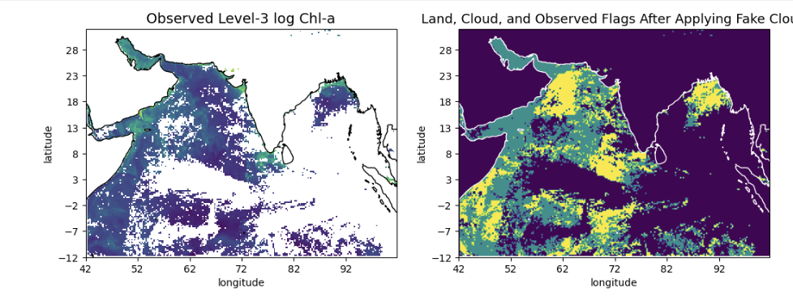
Testing: Using fake clouds to create a test set
Treat as observed and used in the prediction
Fake cloud:
Treat as missing. Compare prediction for these against the truth (actual observed)
Notes:
To train the model based on the gappy data, we cannot just directly fill in the actual clouds (because we would not have true data to validate against)
-> apply artificial fake clouds
Left: actual data, colored ones: values that we have
Goal: apply fake clouds and cover some of actual data, train the model and predict these missing values using the remaining observed chl (yellow parts)
Doing so: test predictions against known values (green parts)

Slide 12
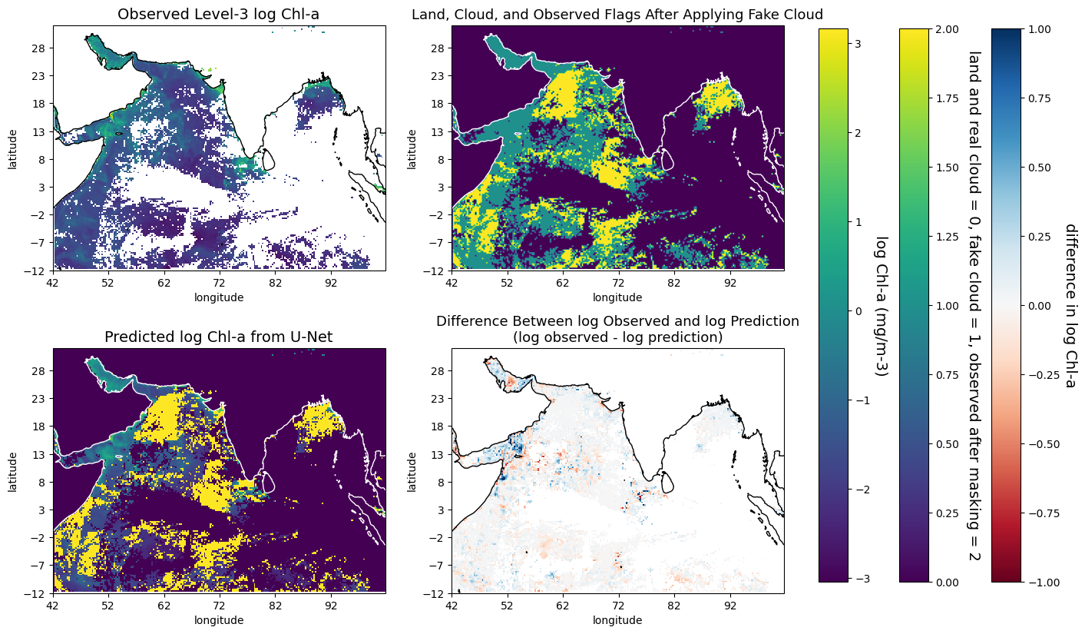
Test: comparison of predictions to held out data
Unfortunately The Section Header is Manual
Notes:
Yifei:
The U-Net model is initially trained to predict the observed, or gappy, chl data (the log scale is shown top left).
Uses chl data masked by fake clouds as an input variable and aims to fill in regions covered by these fake clouds.
Top right flag plot:
Purple: land, real cloud, not worrying about them yet
Green: fake cloud, yellow: remaining chl.
Predict green based on yellow, along with env var (sst, airtemp, wind), time for seasonal info, flags, chl of the prev day and next day
Bottom left: unet prediction
Purple and yellow: flags
Green, blueish parts: predictions
Bottom right: difference in the log scale. (showing how well the prediction is)
What you can see: diffs are generally low, in general the predictions are doing well
!!!! add a takehome message to all the slides

Slide 13
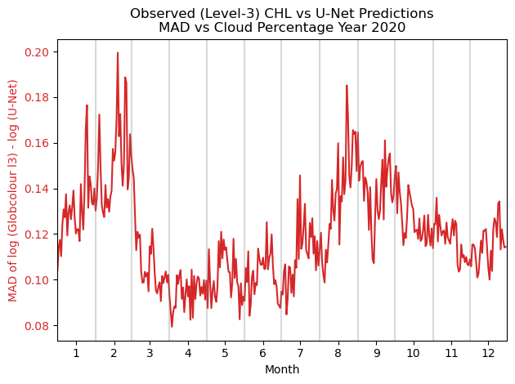
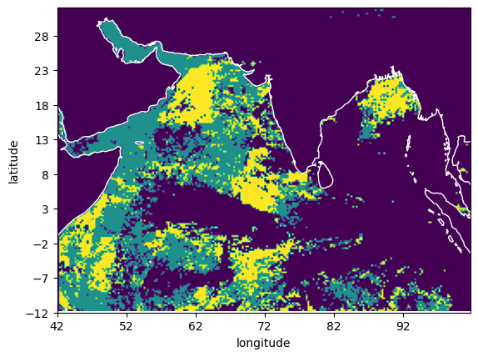
Test: prediction versus true values over a year
Notes:
Evaluate every day in year 2020.
Red line: mad between observed and predict on log scale (only on the green regions where the fake cloud lies)
Difference: ranges from about 10% to 16%, in general low error, doing well

Slide 14
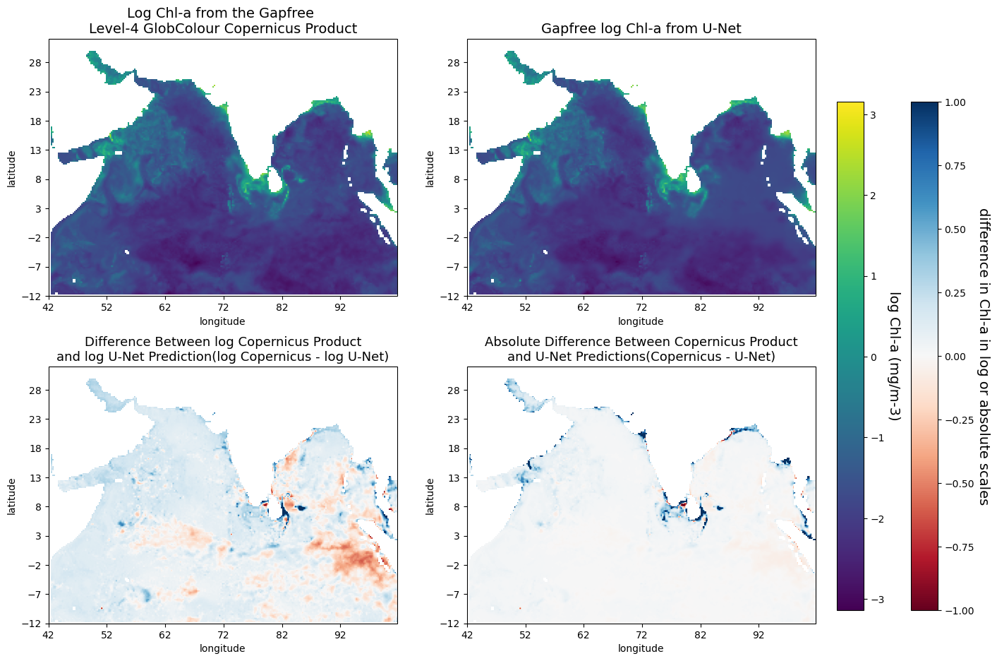
Comparison to Copernicus gapfree level 4
Global Ocean Colour (Copernicus-GlobColour) level 4 gapfree
Main difference along coasts
Notes:
Also compare to the gapfree level 4 product, different alg but based on the same level3 data
Top left: log chl from the level 4 product
Top right: gapfree prediction from unet
Bottom left: difference in the log scale (percentage diff)
Focus on the Bottom right!!!!: diff in abs scale
Abs scale: not very different, but copernicus predicts higher along the coast

Slide 15
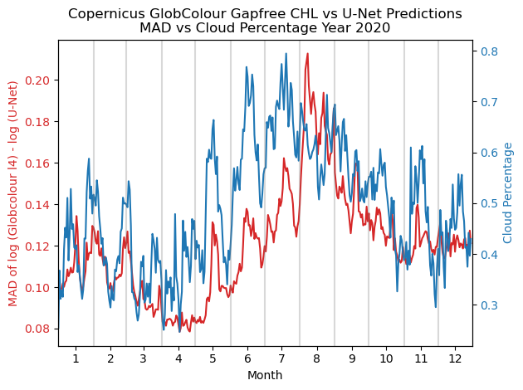
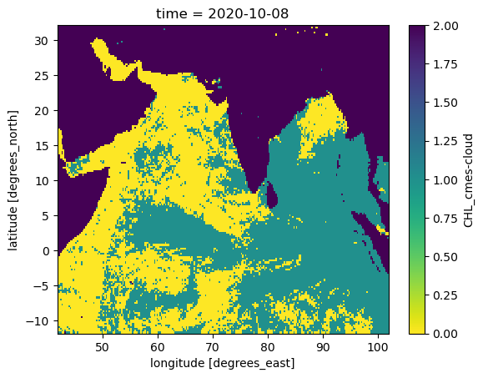
Comparison to Copernicus gapfree over a year
Notes:
Again, the gapfree comparison is evaluated over year 2020.
Flag on the right:
Red line: mad between copernicus and unet on log scale (only for the green regions where the actual clouds lie)
Similarly ranges from about 10% to 20% difference, still pretty low
But we have the blue line
Blue line: real cloud percentage (green / (green+yellow))
Which follows the trend of MAD.
Makes sense in that copernicus calculates missing pixels based on these particular pixels on the same day over all years with valid chl; higher cloud perc -> less chl data -> more variance in prediction

Slide 16
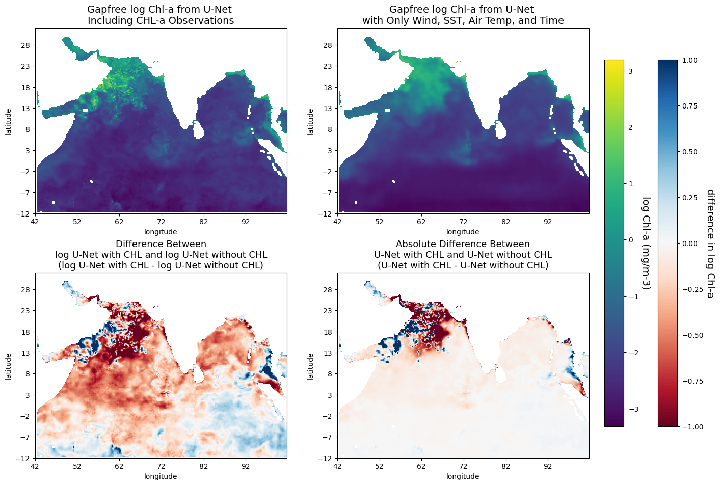
Example results without Chl-a information
Work in progress!
Although there is bias the wind, SST, air temperature, and season ALONE are able to capture the overall pattern.
Notes:
Devloped another model without chl information
In other words, the model needs to predict chl purely based on environmental variables and time
On this four panel plot
Top left: unet prediction with chl
Top right: unet prediction without chl
Bottom left & right: error in the log scale and abs scale, respectively
May observe: the error is high, but the model without chl is still able to capture some general patterns
high concentration in persian gulf, top of arabian sea, and water edges of bay of bengal

Slide 17
U-Net Main Takeaways
U-Net with Chl:
Works well (similar to Copernicus gapfree L4 globColour)
Mainly different along the coast
U-Net without Chl:
Captures general patterns with only wind, SST, air temp and season
Notes:
Unet works well (in comparison to level4)
Difference along the coast: the model can potentially be improved by using more env variables such as bathymetry
unet with vs without CHL:
Downsides: relatively high error and the lost of more detailed patterns
Still promising, captures the general pattern

Slide 18
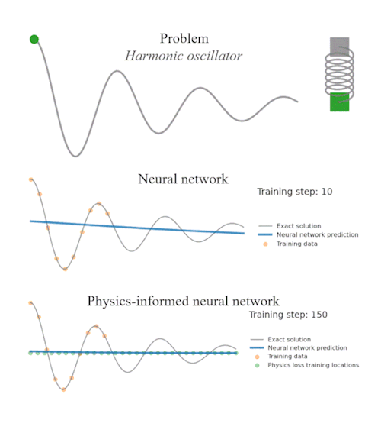
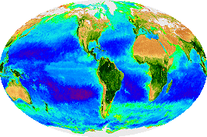
PINN models
Unfortunately The Section Header is Manual
Chlorophyll obeys physical laws!
Data driven approaches do not!
Notes:
Definition:
PINNs integrate physical laws, often represented by partial differential equations (PDEs), into neural network training, ensuring that the network's outputs adhere to known physics.
Core Idea:
Rather than relying solely on data-driven learning, PINNs use physical equations to regularize the learning process, guiding the network towards physically consistent solutions.
Advantages:
Data Efficiency: Requires less data than purely data-driven models, as physical laws provide additional constraints.
Generalization: Models can extrapolate to scenarios with limited data, guided by physical laws.
Interpretability: Solutions adhere to known physics, making them more interpretable and reliable.

Slide 19
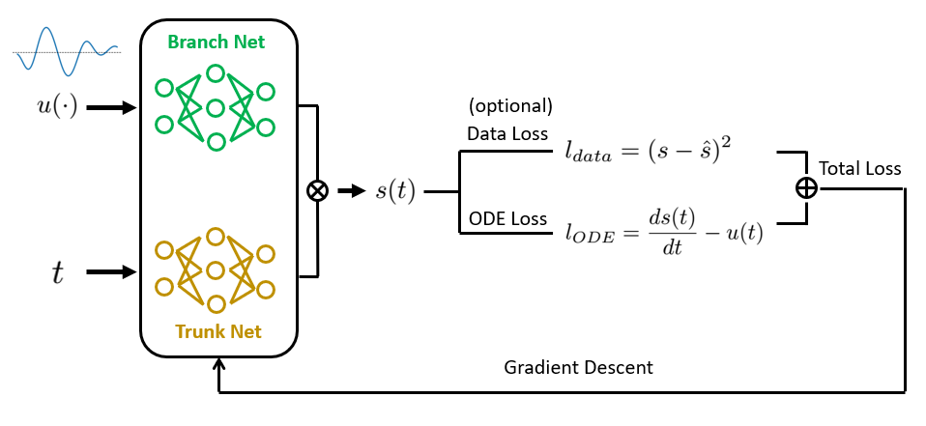
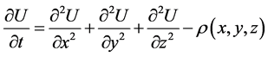
PINN models
Unfortunately The Section Header is Manual
DeepONet (Lu Lu, et al. 2019)
Chl PDE(Matthias Onabid, 2017)

Slide 20
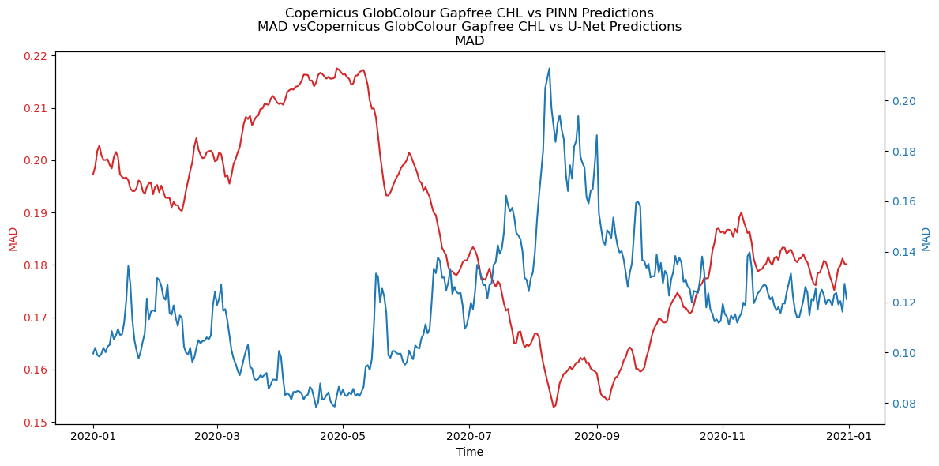
PINN: Results
Notes:
Shridar

Slide 21
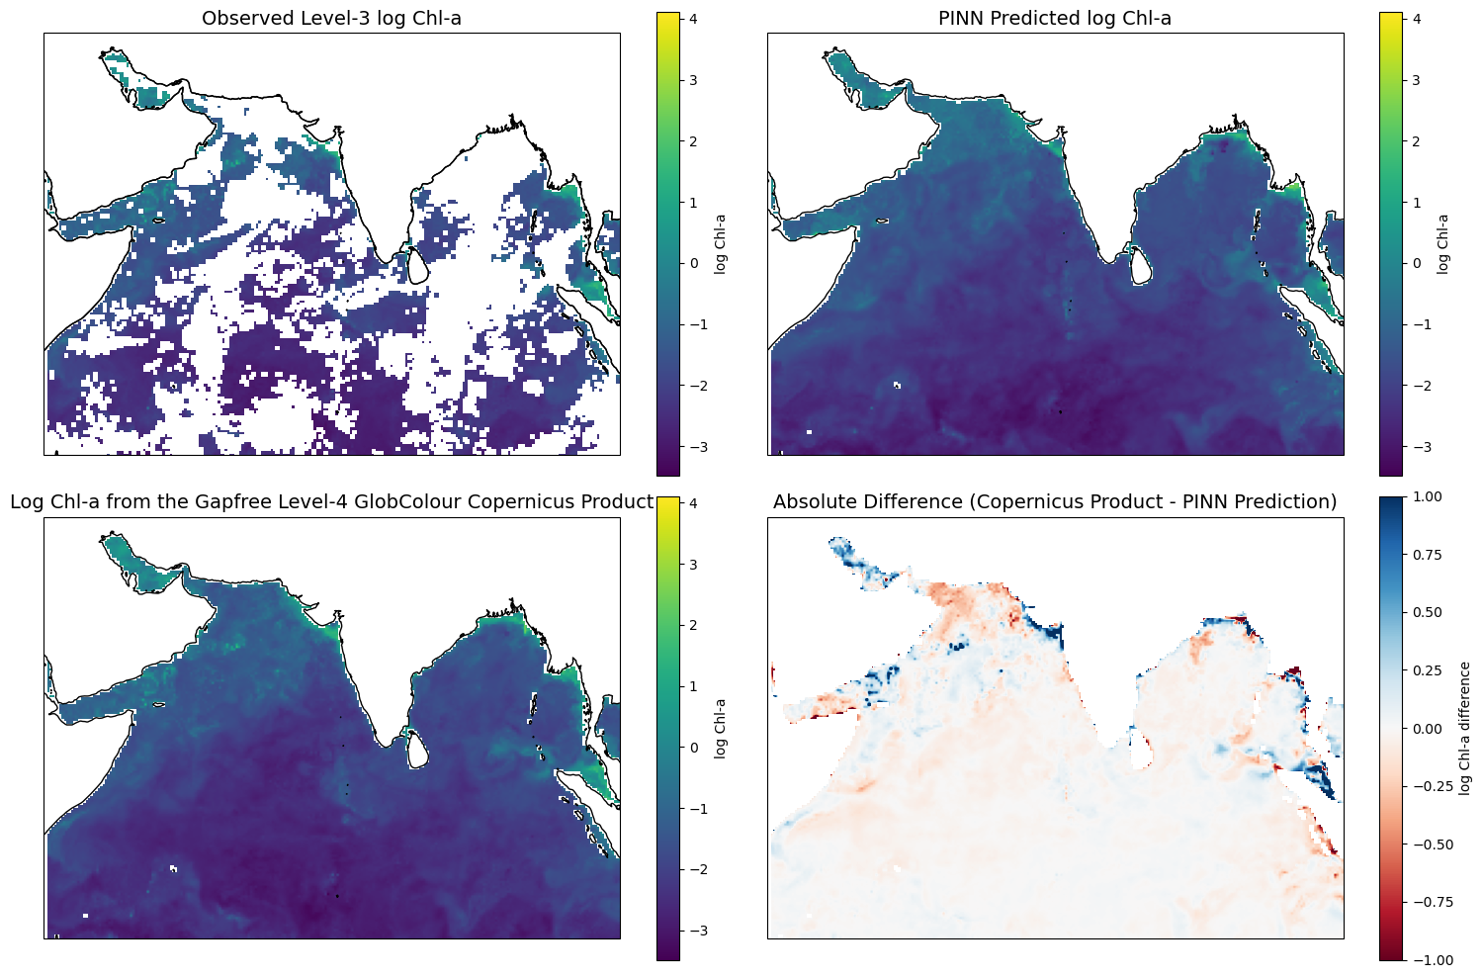
PINN: Results

Slide 22
PINN Main Takeaways
Performance:
Spatially similar to to Copernicus gapfree L4 globColour(Promising!)
Deviates from U-Net and Copernicus significantly in terms of overall value(Interesting!)
Notes:
Unet works well (in comparison to level4)
Difference along the coast: the model can potentially be improved by using more env variables such as bathymetry
unet with vs without CHL:
Downsides: relatively high error and the lost of more detailed patterns
Still promising, captures the general pattern

Slide 23
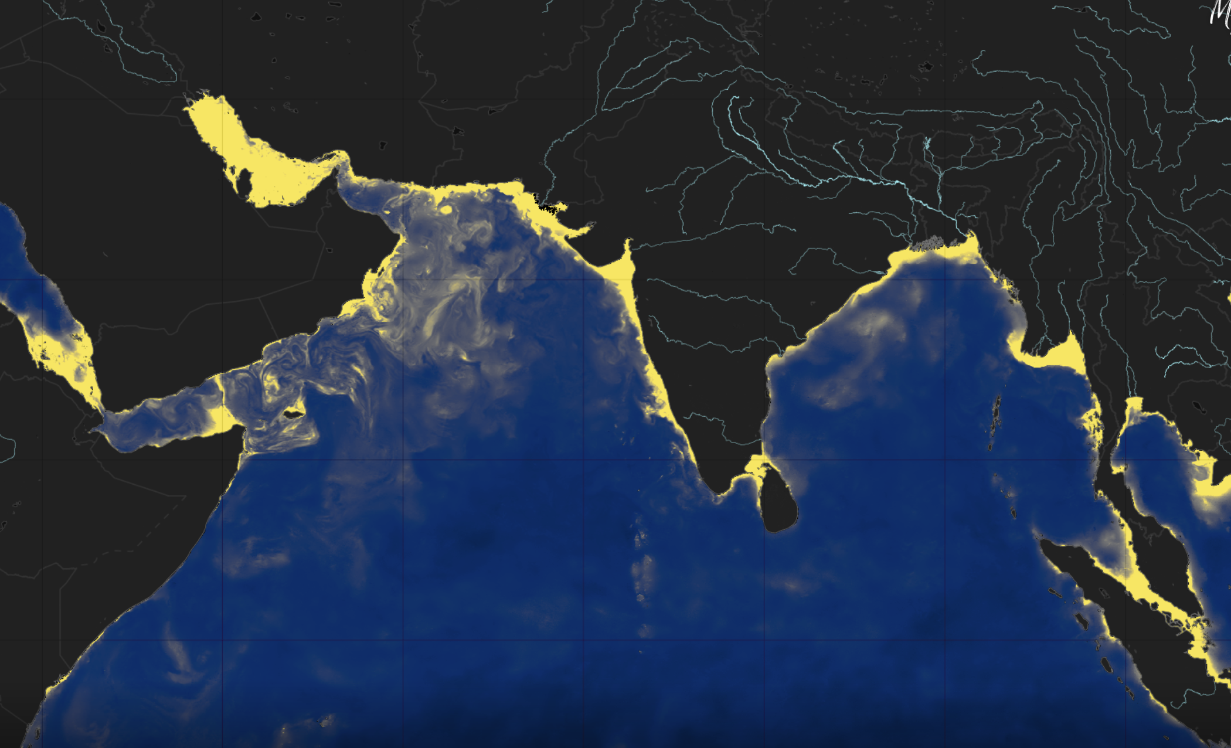

Slide 24
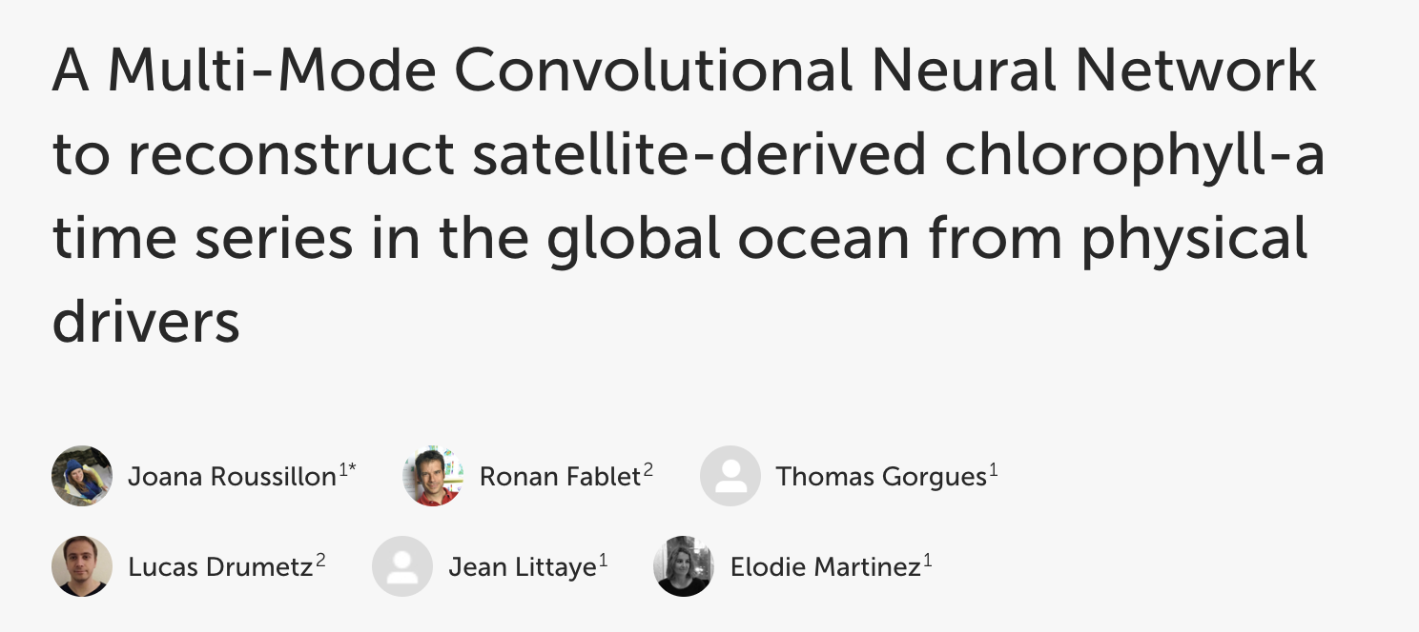
Roussillon J, Fablet R, Gorgues T, Drumetz L, Littaye J and Martinez E (2023) A Multi-Mode Convolutional Neural Network to reconstruct satellite-derived chlorophyll-a time series in the global ocean from physical drivers. Front. Mar. Sci. 10:1077623. doi: 10.3389/fmars.2023.1077623

Slide 25
The Problem: Missing Chlorophyll Data
Key indicator for ocean productivity, crucial for understanding marine ecosystems and managing fisheries.
Limited by the inability to penetrate cloud cover, leading to missing Chl-a data.
High fraction of missing data complicates monitoring efforts, especially in regions with frequent cloud cover.
Notes:
Key indicator for ocean productivity, crucial for understanding marine ecosystems and managing fisheries.
Limited by the inability to penetrate cloud cover, leading to missing Chl-a data.
High fraction of missing data complicates monitoring efforts, especially in regions with frequent cloud cover.

Slide 26
Adding Environmental Data to CNNs
1. Maximize the use of information that we have
Chlorophyll levels are influenced by multiple interrelated environmental factors (e.g., temperature, current speed, wind). The neural net is able to learn most of these relationships.
2. Improved Contextual Understanding
Spatial Correlation: Data from the same location provides a consistent context, enhancing the network's ability to learn spatial patterns and dependencies specific to chlorophyll distribution.
Notes:
Yifei
Chlorophyll concentration is influenced by envir data.
Eg. wind -> drives upwelling -> the upwelling regions have higher concentration of nutrients -> promotes phytoplankton growth -> increase chl concentration
Incorporating env factors -> potentially better predictions
Altho Some relationships between env data & chl concentration are more complex, nn will be able to learn most of the relationships.

Slide 27
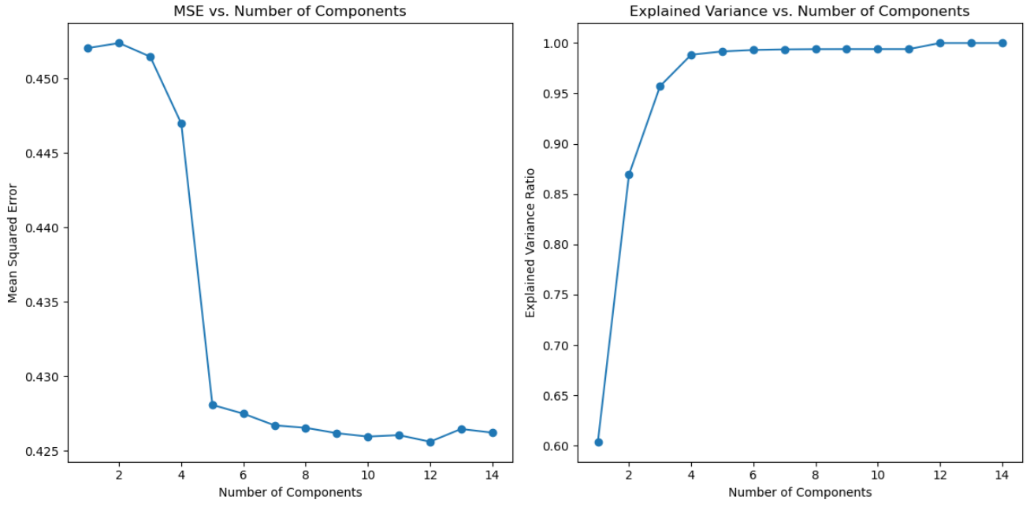
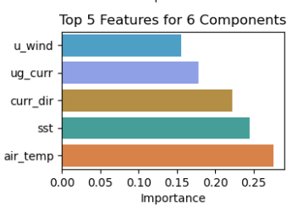
Feature Importance Analysis
Principal Component Analysis reveals dependence on several key features

Slide 28
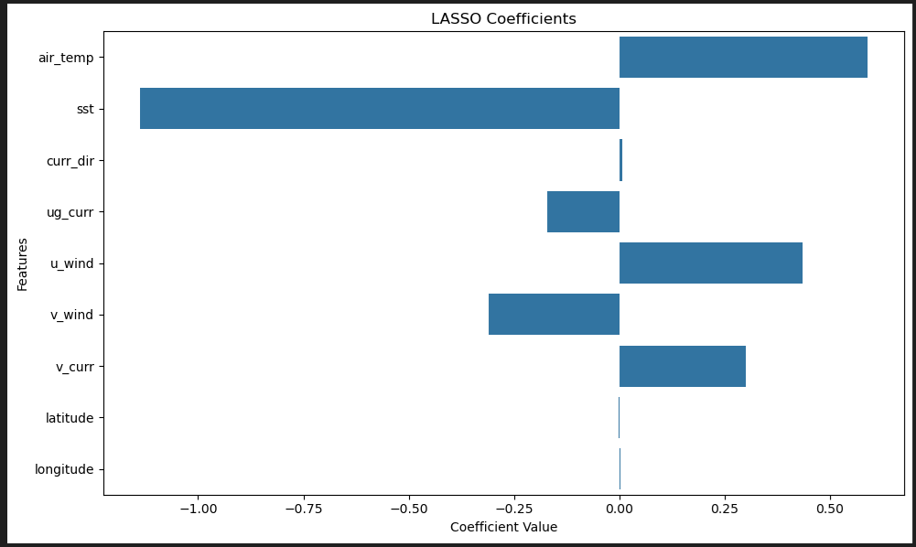
Feature Importance Analysis
LASSO sparsifies the environmental dependences and reveals the correlation

Slide 29
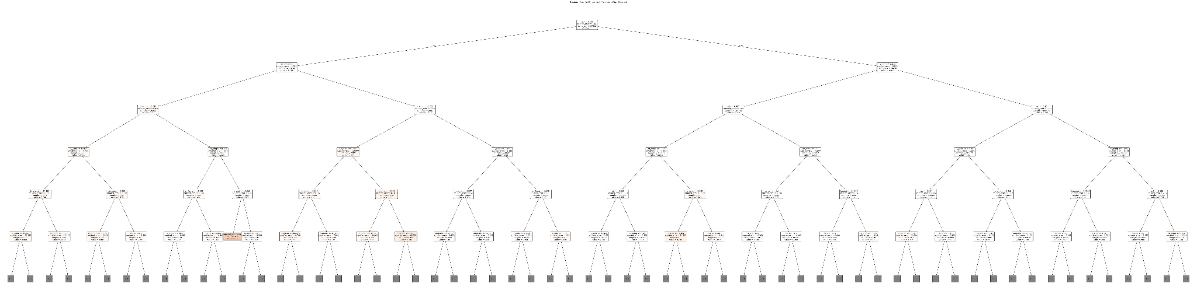
Feature Importance Analysis
Decision Trees allow us to examine importance of many variables and allow flexible relationships
Notes:
Shridar
So trees are good for sorting out what is important when you have many many variables.

Slide 30
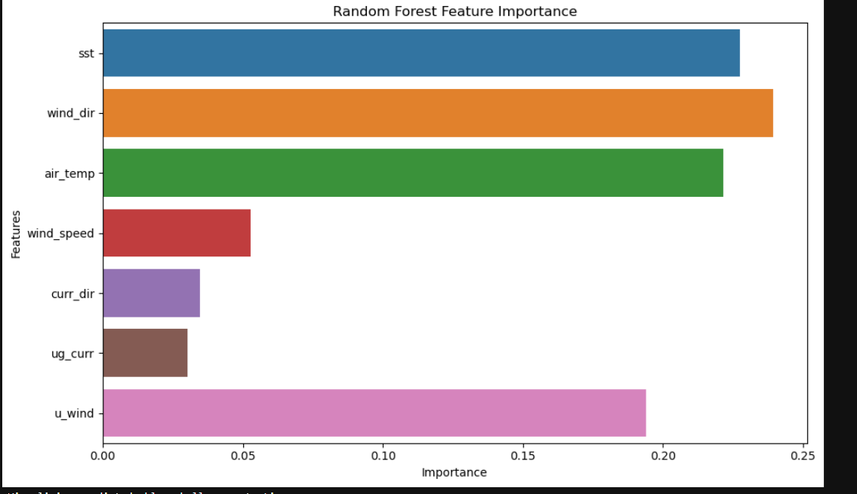
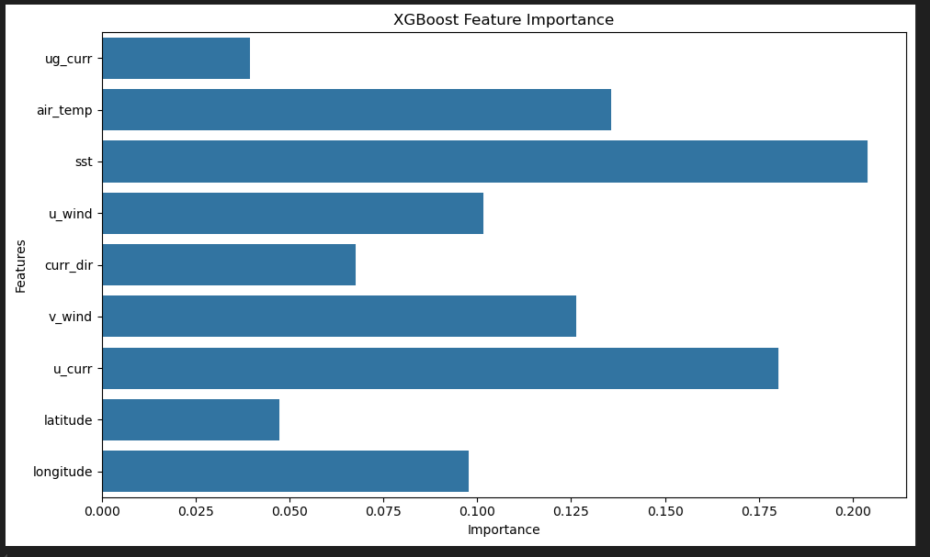
Feature Importance Analysis
Random Forest and Gradient-Boosted Trees learn and reveal non-linear dependencies
Add the key result:
SST
Winds
Air temperature
Currents
Notes:
Shridar
CNN take care of the latitude and longitude.

Slide 31
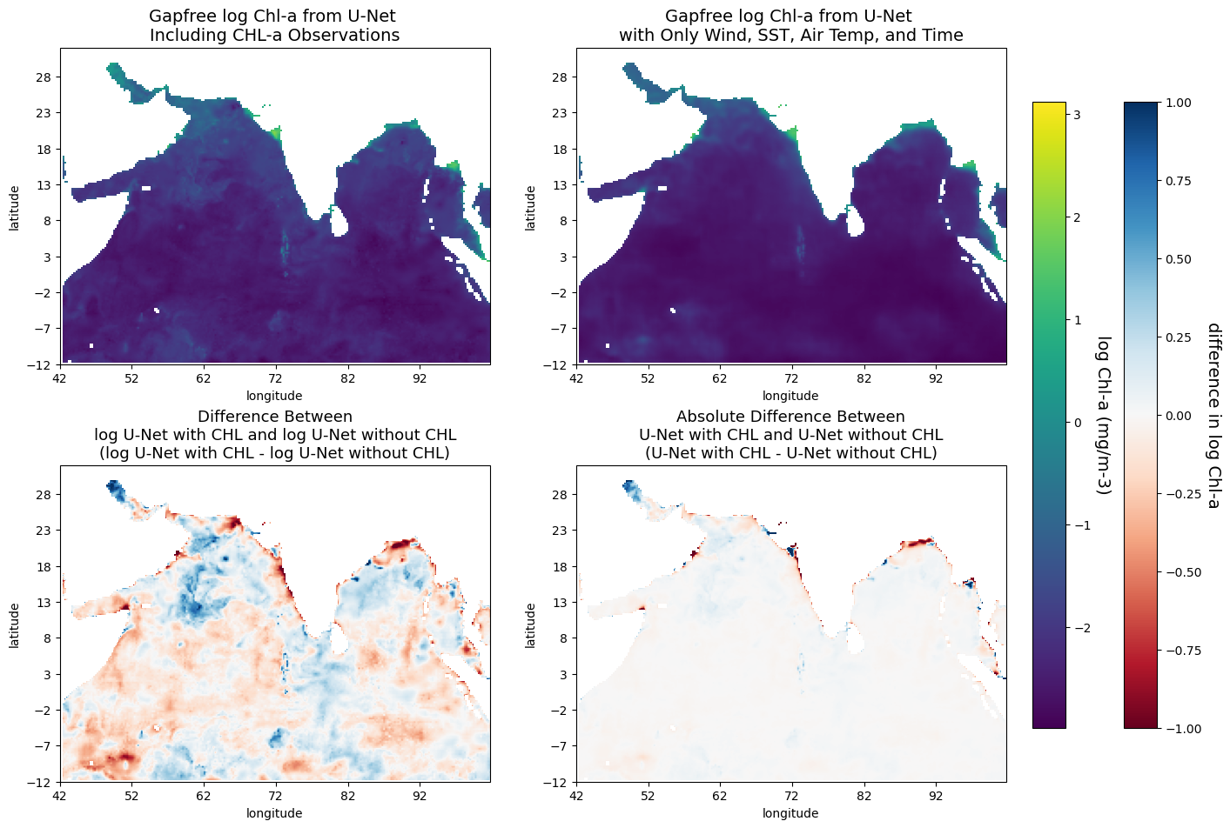
Results without Chl-a information
Notes:
Yifei
Question: can the model predict chl without chl given
Described by background text: top best performing, bottom worst performing (two 4-panel plots with log diff and absolute diff)
Lower error, but Chl level also lower, getting green parts at the top and blobs at the bottom
Good example: 2020-04-26
Top: Good example - UNet wo Chl looks similar to UNet w Chl
The selection would be based on the next slide’s error plot

Slide 32
Feature Importance Analysis
The key result: the most important variables were
SST
Winds
Air temperature
Currents
Notes:
Shridar
CNN take care of the latitude and longitude.

Slide 33
Gap-filling performance of the deep-learning models
Notes:
Shridar

Slide 34
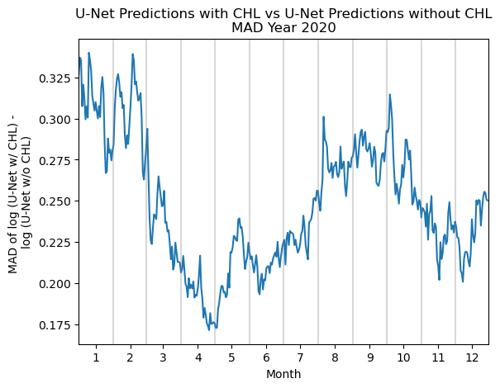
Results without Chl-a information
Notes:
MAD between pred w/ CHL and pred w/o. No pixels taken out (no CHL model is doing pure predictions
Add a summary slide with a few bullet points of the main analyses/take home messages
Unet works well (in comparison to level4)
Difference along the coast
unet with vs without CHL: promising, captures the general pattern

